Slide 1
SAMSUNG PRISM
Project Title :- Real vs Recorded/Artificial Sound Classification

Slide 2
Understanding Speech & Non Speech recognition Concept :-
Speech and Non Speech recognition is the capability of an electronic device to understand spoken/recorded words. A microphone records a person's voice and the hardware converts the signal from analog sound waves to digital audio. The audio data is then processed by software, which interprets the sound as individual words.
To identify the difference between original and recorded one we use some python libraries.

Slide 3
Speech and Non Speech Features:-
We use different types of features of speech and non-speech to compare them and differentiate them, these features are:-
Time Domain Waveform
Spectrogram
MFCC
Log-mel
To extract the features of speech and non-speech we use a dataset where there are different types of sounds are present in it.

Slide 4
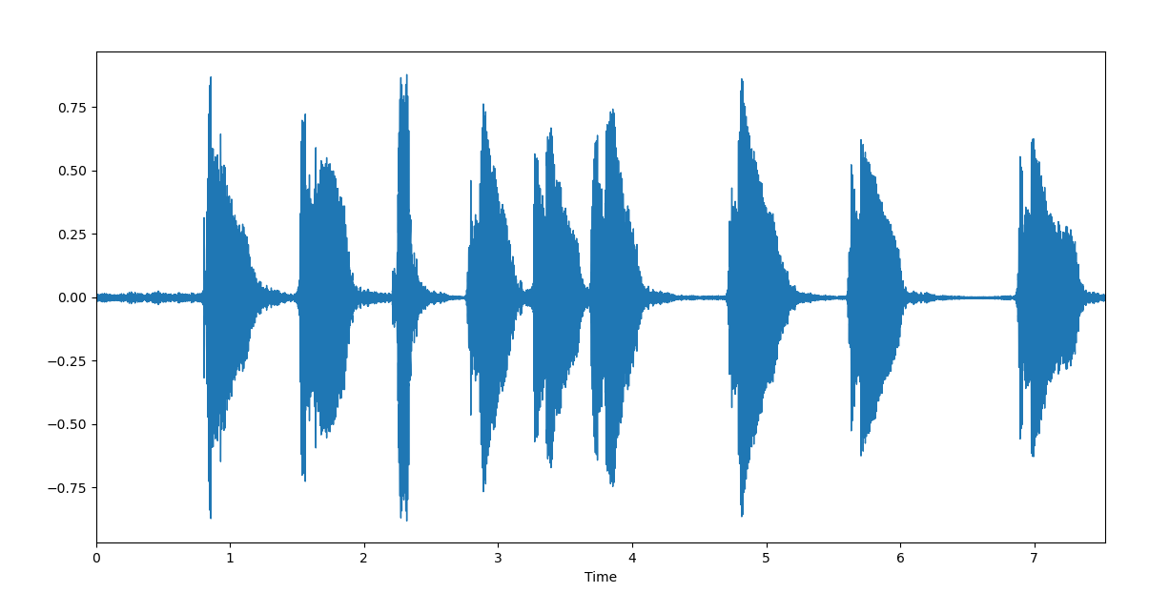
There is some steps to extract the features of sound from dataset:-
First we read the dataset then we extract the waveform of different types of sound to extract the features and plot we mainly use numpy, mathplotlib, librosa, sklearn a python library.
Code for Waveform
import matplotlib.pyplot as plt
import librosa
import librosa.display
audio_path = './sounds/set_b/pkaudio.wav'
x , sr = librosa.load(audio_path)
plt.figure(figsize=(14, 5))
librosa.display.waveplot(x, sr=sr)
plt.show() (a) Waveform of speech

Slide 5
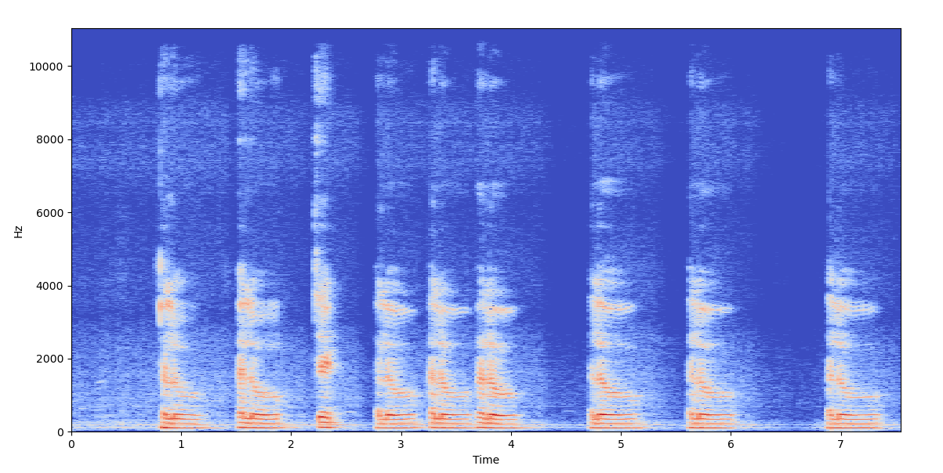
Code for Spectrogram
import matplotlib.pyplot as plt
import librosa
import librosa.display
audio_path = './sounds/set_b/pkaudio.wav'
x , sr = librosa.load(audio_path)
X = librosa.stft(x)
Xdb = librosa.amplitude_to_db(abs(X)) (b) Spectrogram form of speech
plt.figure(figsize=(14, 5))
librosa.display.specshow(Xdb, sr=sr, x_axis='time', y_axis='hz')
plt.show()

Slide 6
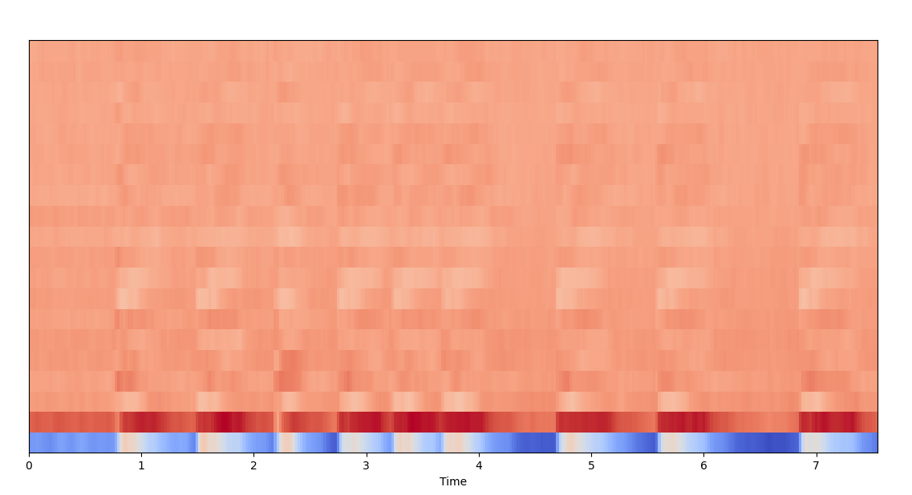
Code for MFCC
import matplotlib.pyplot as plt
import librosa
import librosa.display
audio_path = './sounds/set_b/pkaudio.wav'
x , sr = librosa.load(audio_path)
plt.figure(figsize=(14,5))
mfccs = librosa.feature.mfcc(x, sr=sr) (c) MFCC form of speech
print(mfccs.shape)
librosa.display.specshow(mfccs, sr=sr, x_axis='time')
plt.show()

Slide 7
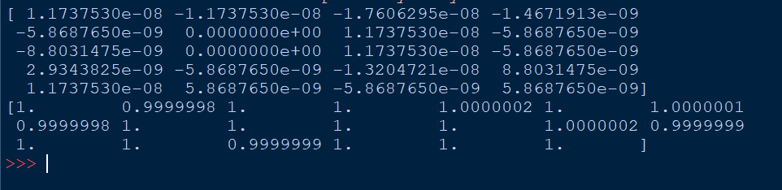
=>> We extract log-mel form of speech and non-speech because for machine/model its tough to differentiate so we give numerical data. To extract log-mel feature of speech we use sklearn library.
Code for Log-mel
import sklearn
import matplotlib.pyplot as plt
import librosa
import librosa.display
audio_path = './sounds/set_b/pkaudio.wav'
x , sr = librosa.load(audio_path)
mfccs = sklearn.preprocessing.scale(mfccs, axis=1) (d) Log-mel form of speech
print(mfccs.mean(axis=1))
print(mfccs.var(axis=1))

Slide 8
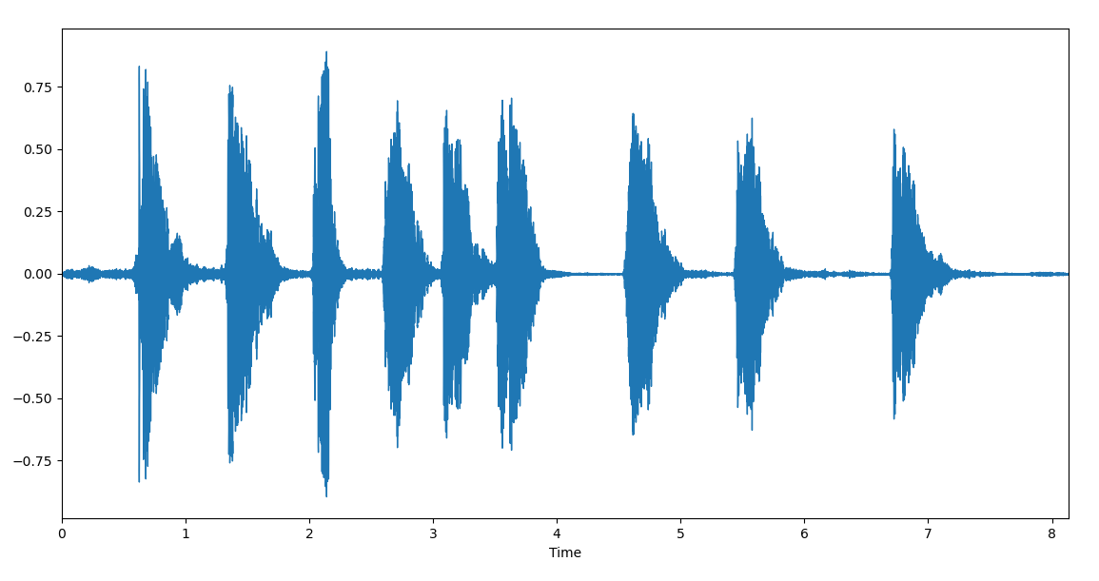
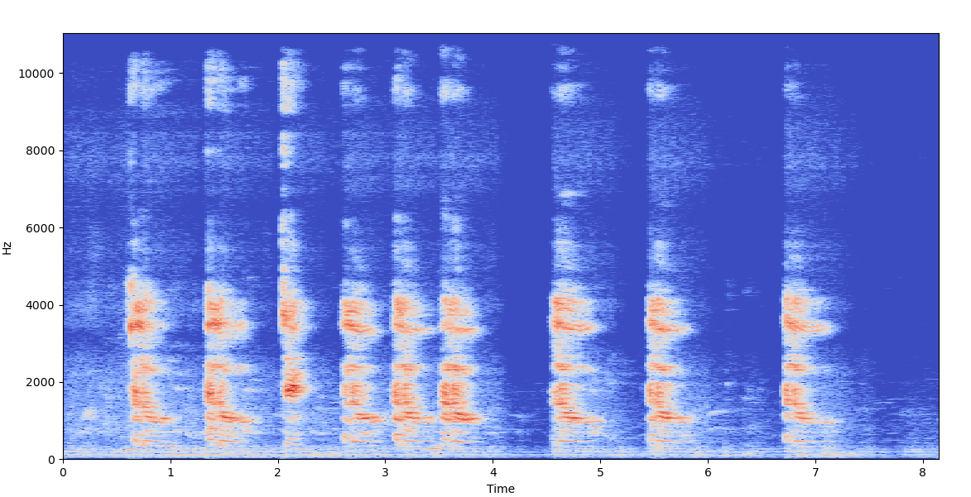
Compare different features of speech and non speech :-
Original Speech Recorded Speech
(a) Waveform
(b) Spectrogram form

Slide 9
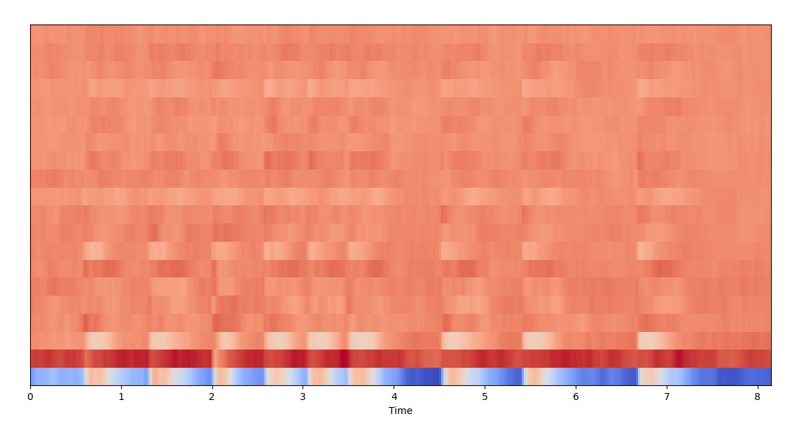
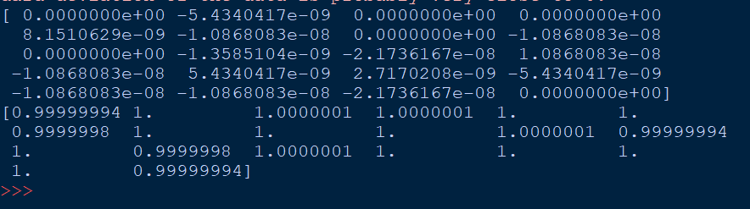
Compare different features of speech and non speech :-
Original Speech Recorded Speech
(c) MFCC form
(d) Log-mel Form

Slide 10
Next Step is to build our model :-

